Slide 1


Data analysis and predictive modeling of listings on Roofstock
Group 1(Alphabetical Order)
Yupeng Cui
Yefei Fan
Huimin Han
Bing Wu

Slide 2
CONTENTS
01
Executive Summary
02
Data Overview
03
Data Preprocessing
04
Exploratory Data Analysis
05
Data Modeling
06
Recommendations

Slide 3

1
Executive Summary
Data Overview
St
Data Preprocessing
Exploratory Data Analysis
Data Modeling
Recommendations

Slide 4



Business Background and Project Goal
Why this topic is important for RoofStock?
This information is equally important for both a potential buyer and the seller. With this information the seller will have an understanding of what she can do to expedite the sale, i.e. reduce the asking price, renovate/remodel some home features, etc. On the other hand, a potential buyer will have an idea of the available time for her to react i.e. to place an offer. Hence, improve the user experience when they are doing SFH investment.
Client Overview
Roofstock provides a transparent and efficient marketplace for single-family home investments.
Business Goal
Analyze the process of receiving an offer.
Estimate time to reasonable offer for a particular price.

Slide 5
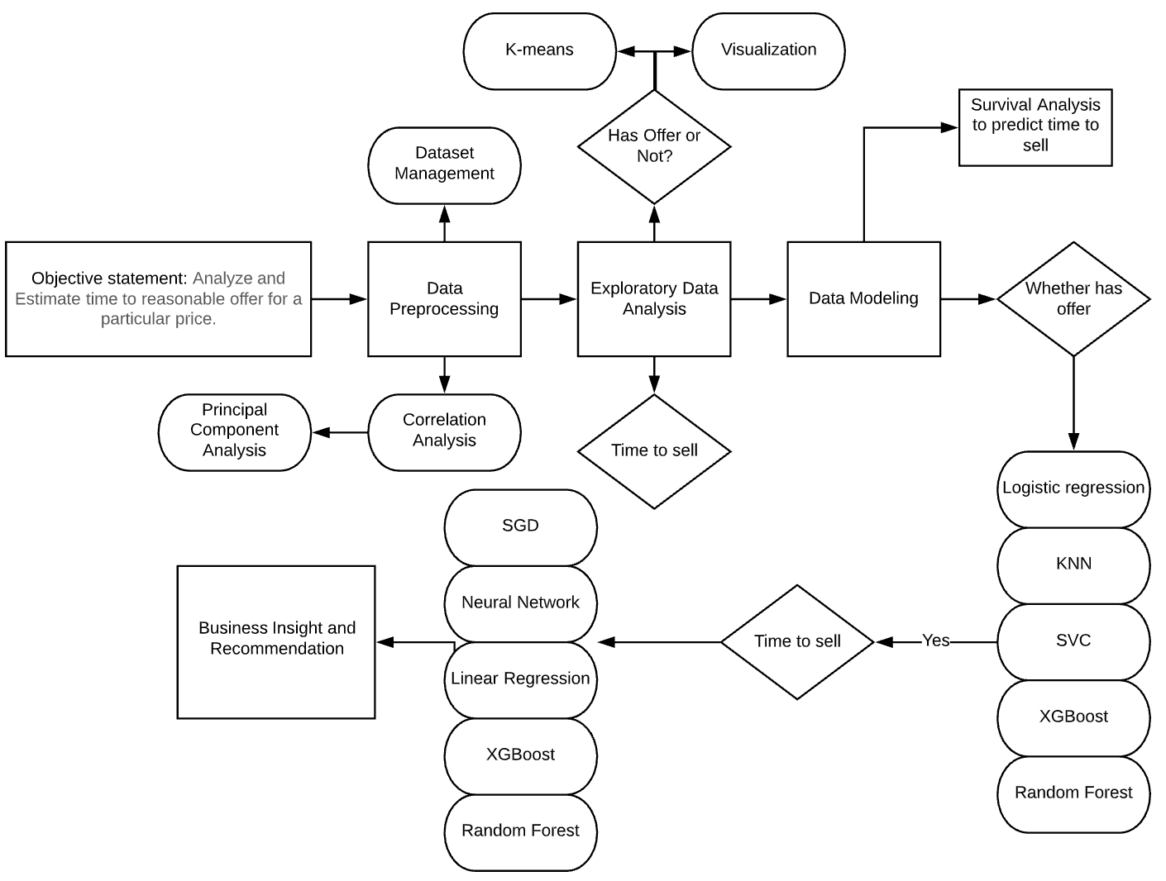

Analysis Roadmap

Slide 6
2
Executive Summary
Data Overview
nd
Data Preprocessing
Exploratory Data Analysis
Data Modeling
Recommendations

Slide 7
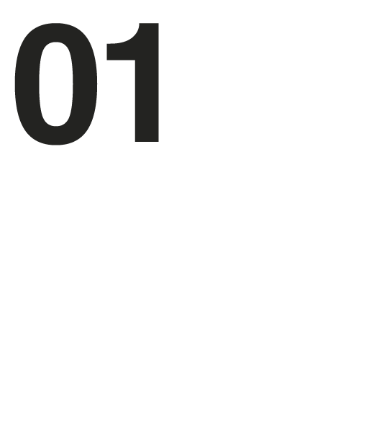



Data Overview
BUYER
TRANSACTION
LISTING
2610 rows, 30 columns
1769 rows, 13 columns
OFFER
14344 unique listings IDs
7403 unique listings has initial publish date
3234 unique listings have offer(s) (including transaction offer_id=-99(‘Buy it now’))
31852 rows, 42 columns
2895 unique listing IDs

Slide 8
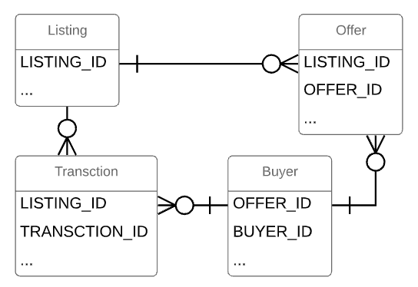

Relationship Diagram

Slide 9
3
Executive Summary
Data Overview
Data Preprocessing
rd
Exploratory Data Analysis
Data Modeling
Recommendations

Slide 10

Define Target Variable
ISSUE 1
1
Listings without offer don’t have any attributes of offer information, such as offer price.
ISSUE 2
2
Imputing offer attributes for those listings may introduce bias into the dataset.
About Offer
OFFER_OR_NOT
3
(boolean variable) whether a listing has an offer within 180 days or not.
4
DIFF_DAYS
(numerical variable) the difference of PUBLISHED_INITIAL_TS of a listing and EVENT_UTC of an offer.

Slide 11



Data Manipulation
Delete Current Variables
Text/ Unstructured feature:
such as PROPERTYHIGHLIGHTS
Features with over 50% missing values:
such as RESERVEDEPOSIT, all NAs
Features explaining the same things:
such as LISTING_SOURCE_ID and LISTING_SOURCE, only maintain the latter one.
Useless Features: such as VIRTUALTOURURL
Unique Identifier: such as ACCOUNT_ID
Correct Wrong Data
STATE:
'PA , 15001' → ‘PA’
FLOODRISKSCORE:
'\tX' → ‘X’

Slide 12
Data Manipulation
Change Variable Types
Fill Missing Value
Float → Categorical:
such as ROOFCONDITIONID
Object → Categorical:
such as LISTING_STATUS
Object → Datetime:
such as LISTING_INITIAL_PUBLISH_DATE
Categorical feature:
create a new level
Numerical feature:
group by STATE,
filtered with price range of +- 20000,
then fill NA with the group’s median

Slide 13
Feature Engineering
Create New Variables
Use Zillow API
HOUSEAGE: the difference of YEARBUILT and current date
INITIAL_PUBLISH_MONTH: extract month from LISTING_INITIAL_PUBLISH_DATE
OFFER_MONTH: extract month from EVENT_UTC
ZESTIMATE: Zillow’s estimated market value for a home.
ZESTIMATE_DIFFERENCE: the difference of Zillow’s estimated price and Roofstock listing price.
ZESTIMATE_DISCOUNT: the ratio of Zillow’s estimated price to Roofstock listing price.

Slide 14


Feature Extraction
Dummy Variable
Scale Variable
Prepared for Data Modeling part
Transform every level to a new variable, such as LISTING_STATUS_For_sale.
Scale all numerical variables for distance-based modeling

Slide 15
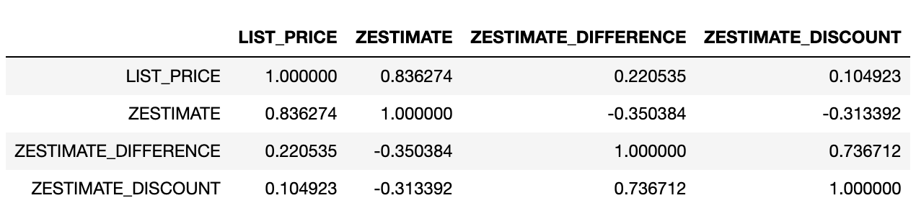
Correlation Analysis
01
From the chart above, we can see that the correlation between LIST_PRICE and ZESTIMATE_DIFFERENCE is the lowest, about 0.22.
Thus, in the modeling part, we will only maintain ZESTIMATED_DIFFERECE to reduce the correlation impact on model interpretation. In addition, ZESTIMATE is more intuitive compared to ZESTIMATE_DISCOUNT.
Findings

Slide 16
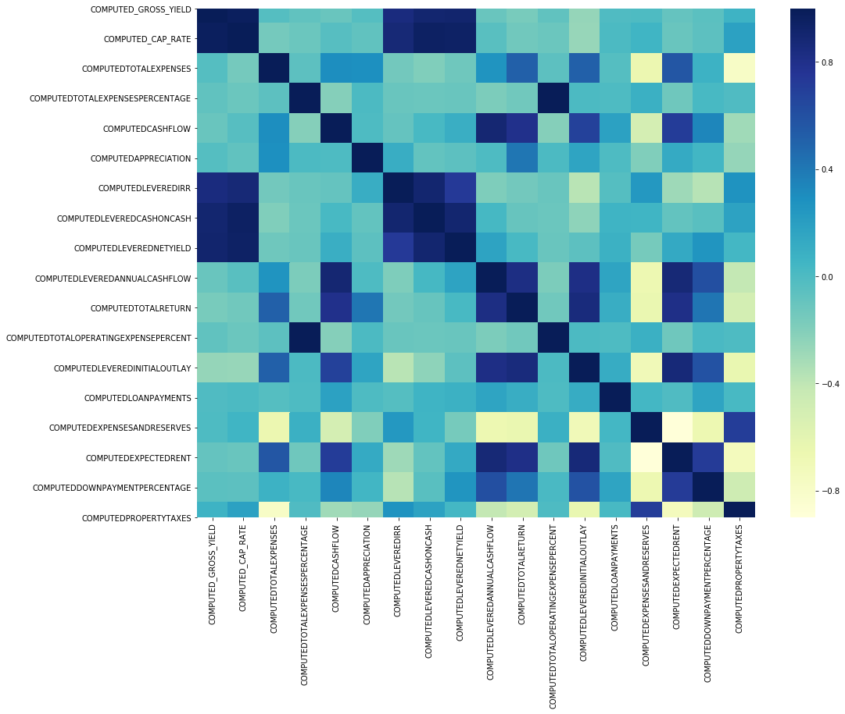
Correlation Analysis
Findings
02
From the heatmap of financial information, it can be seen that some variables are highly correlated with each other, such as COMPUTED_GROSS_RATE and COMPUTED_CAP_RATE.
In the EDA part, we will choose one of two highly correlated variables to analyze.

Slide 17
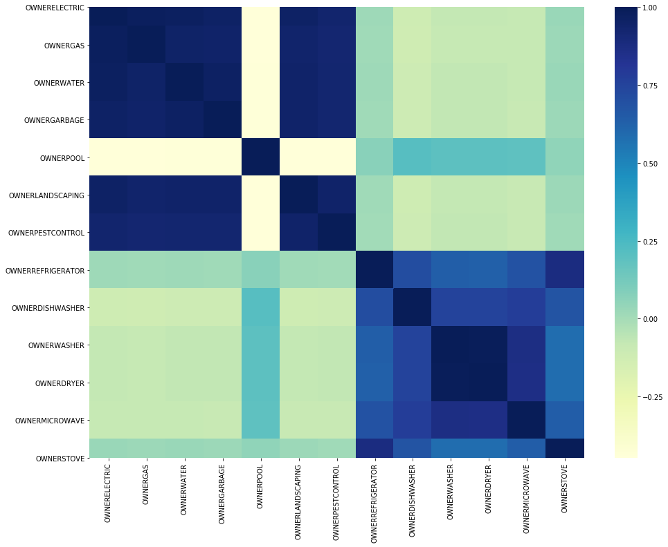
Correlation Analysis
Findings
03
The house property features are highly correlated with each other, such as OWNERELECTRIC and OWNERGAS, OWNERWASHER and OWNERSTOVE.
Thus, we would use Principal Component Analysis (PCA) to combine those features in future modeling part.

Slide 18
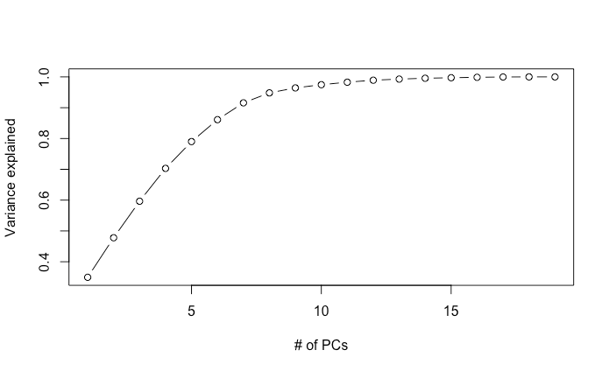
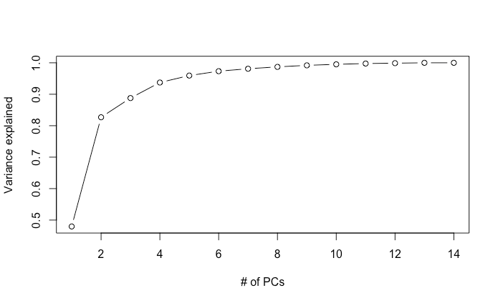
Principal Component Analysis
PCA
Financial variables(totally 28 variables)->8 PCs
Owner Property variables(totally 12 variables)->4 PCs

Slide 19
Training Dataset Preparation
By extracting those listing IDs with offer(s) in the offer and transaction data, we found that all (listing_id missing initial_publish_TS) do not show up in the listing_id with offer(s). We assume that those listings have never published before so that we eliminate those listing records.
In the offer table, it does not have the ‘buy it now’ records. We merge all offers and transactions with offer_id = -99.
1
2
We extract all offer records with the nearest listing static data.
3
A B C D E
Initial publish date
Record
Change 1
Offer 1
Record
Change 2
Offer 2
The first row: listing static data at B + offer price at C ---- C-A as time to sell
The second row: listing static data at D + offer price at E ---- E-A as time to sell

Slide 20
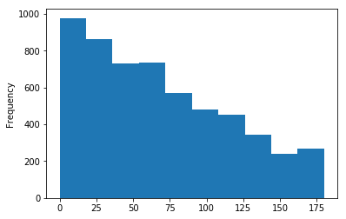
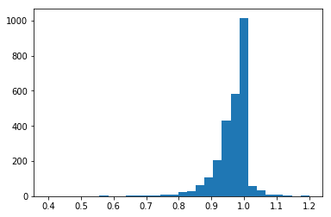
Training Dataset Preparation
Some listings do not have any offer at all, to give the model information that they should have a very long time to sell (no offer):
4
For y label (time to sell): 180 days --- the maximum number of time to sell
For offer_price: From the discount distribution, most offers have less than 10%-off discount
Set an impossible discount: random(0.5,0.8)
list price*discount = offer price

Slide 21

Training Dataset Preparation
Listing records contain different status of listings (for sale, cancelled, purchased, etc. )
5
We only need the listing records when they are not off-market
Only keep records with listing_status = for sale

Slide 22

Executive Summary
4
Data Overview
Data Preprocessing
Exploratory Data Analysis
th
Data Modeling
Recommendations

Slide 23
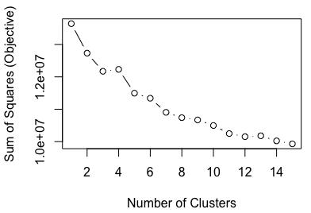


Clustering (K-means)
Goal
To get the first sense of our dataset: is there a distinct difference among clusters?
Choose Clusters
From the Elbow Plot, we choose cluster = 5

Slide 24
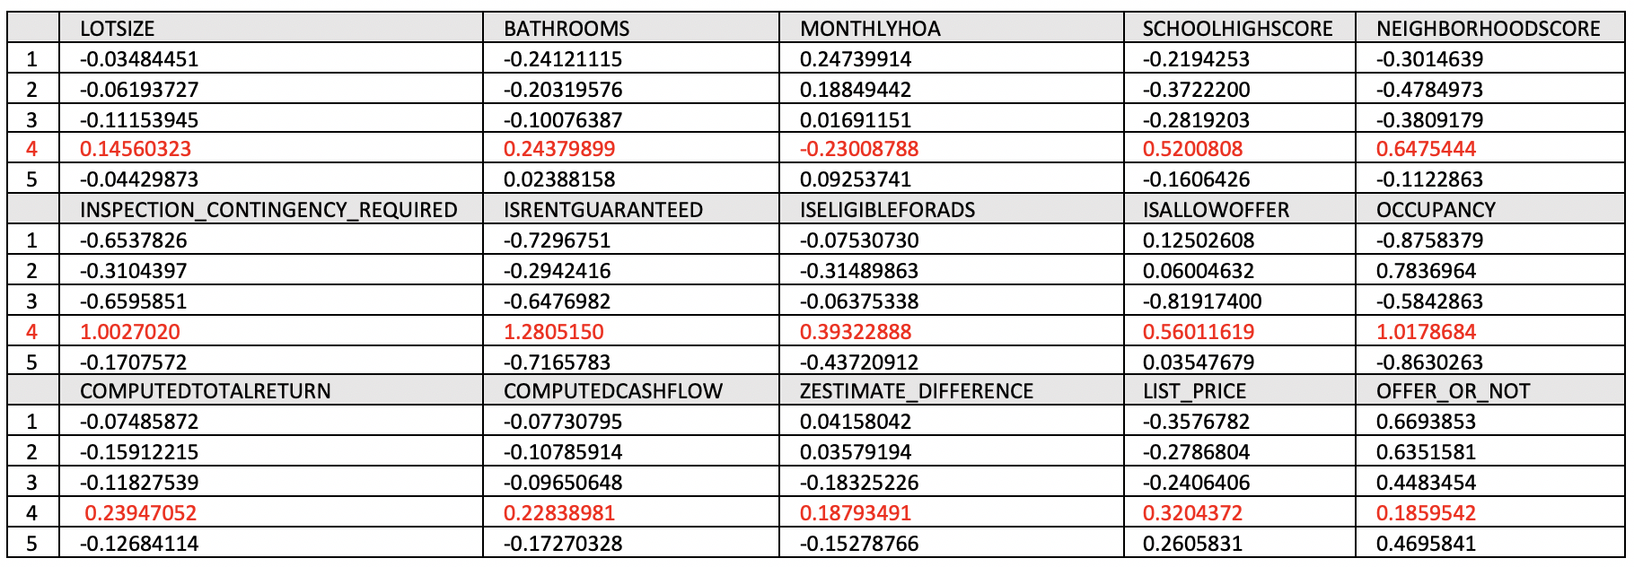
Cluster Means
Findings
From the cluster means chart, it can be seen that Cluster 4 is distinct from other Clusters, especially in the features listed above.

Slide 25
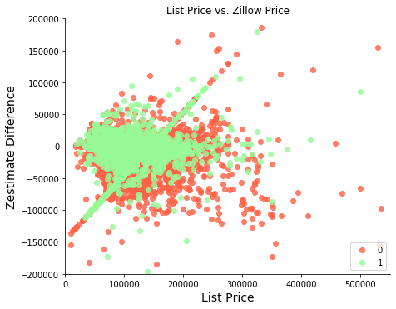
List Price and Zestimate
Findings
When the listing price gets close to 250000, the listing price tends to be far away from zestimate valuation, and fewer listings get an offer.
When a listing’s price is in the high-end market, strategy of lowering the price doesn’t work well.

Slide 26
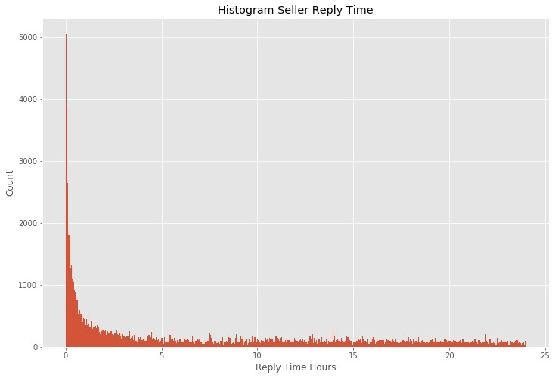
When will a seller reply?
Findings
Most of the sellers reply to the buyers within 5 hours.
If a seller hasn’t reply within 5 hours, RoofStock can send out a notification to remind the seller to reply to the offer.

Slide 27
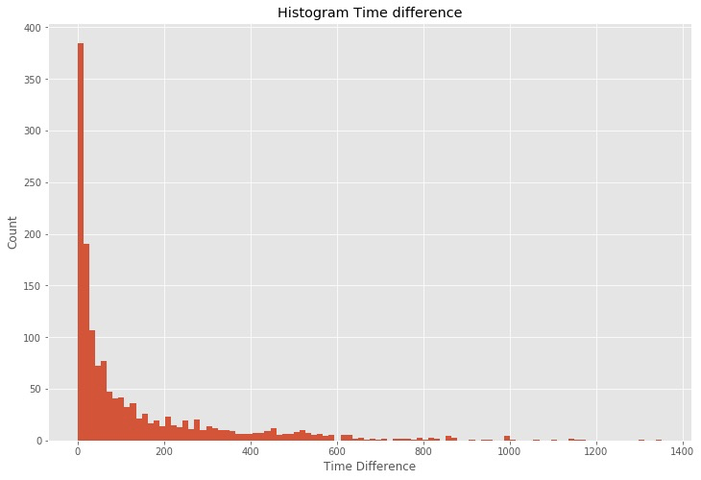
When will a buyer send out an offer after registration?
Findings
Most of the buyers send out an offer with 150 days after registration.
If a new user hasn’t sent out any offer after 150 days of registration, Roofstock can choose to send out promotion regularly to stimulate the user to invest through RoofStock.

Slide 28
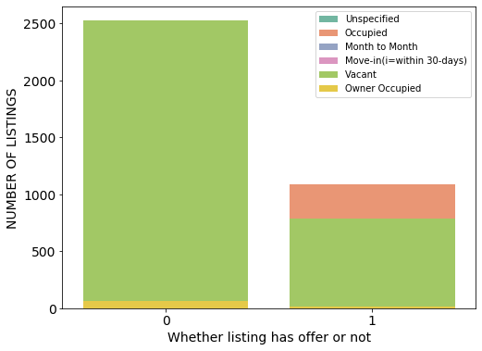
Occupancy
Findings
It can be seen that most listings without offers are vacant, while listings with offers are occupied or vacant.
Roofstock could recommend the seller to have tenant before publish, which may help to sell faster.

Slide 29
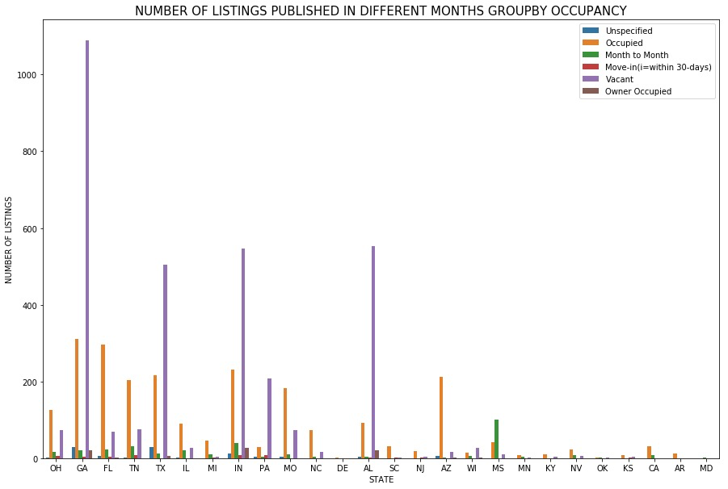
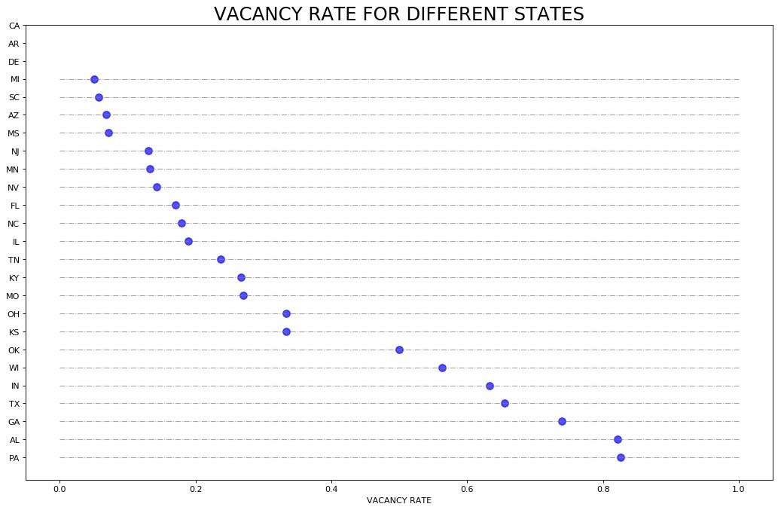
Occupancy and Vacancy Rate
Findings
For the buyer, PA and AL markets have high risk.
Seller, in PA and AL, could try to lower the listing price and improve property quality.

Slide 30
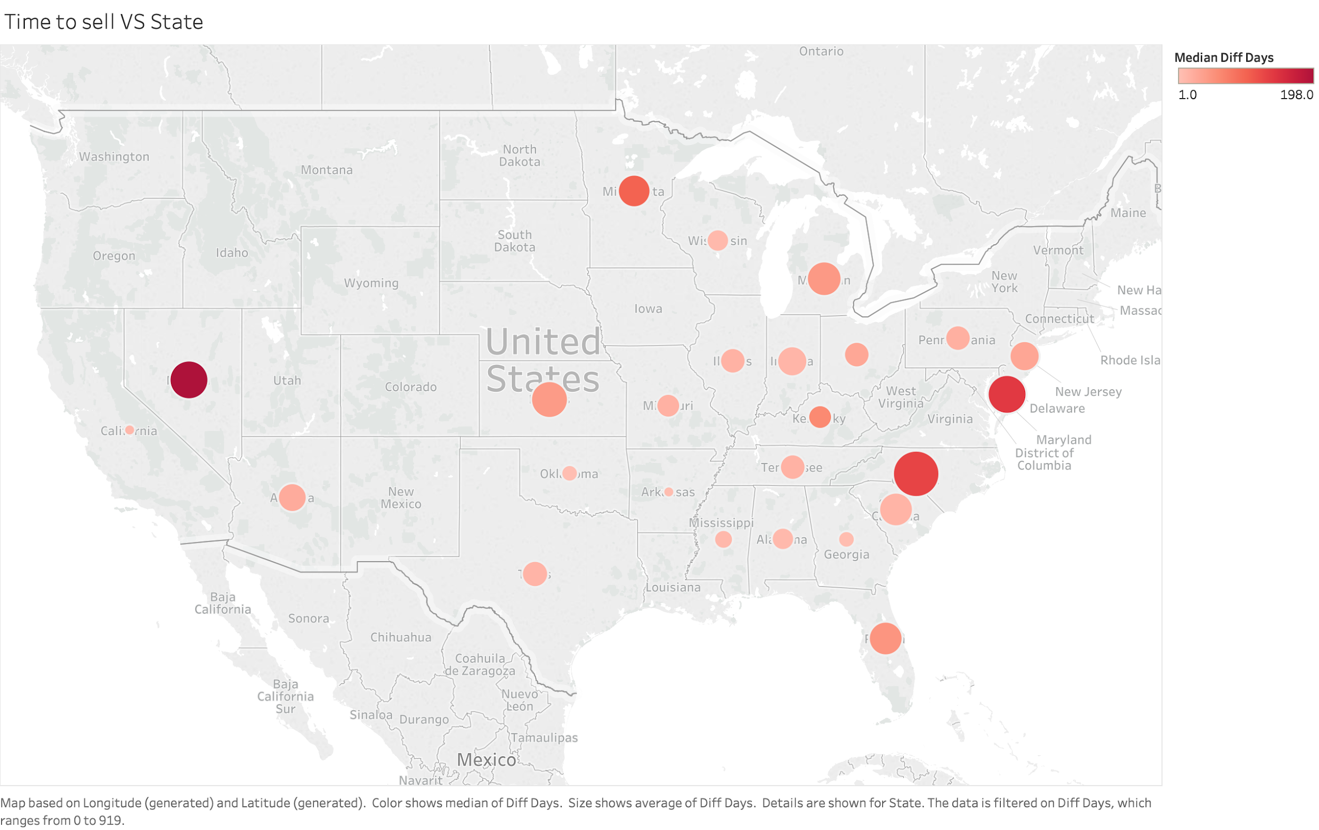
Occupancy and Vacancy Rate
Findings
Listings in states like NV, NC, DE, MN tend to spend a longer time to get an offer.
Some states like KS, MI have a higher mean value of ‘time to sell’ than median value, which means some individual listings spend an unusual longer time to get an offer.

Slide 31
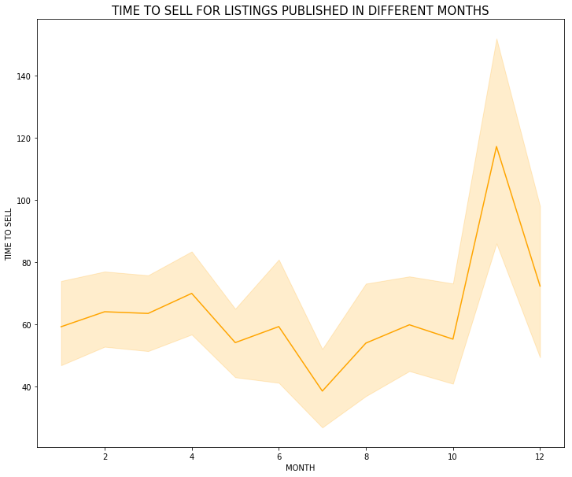
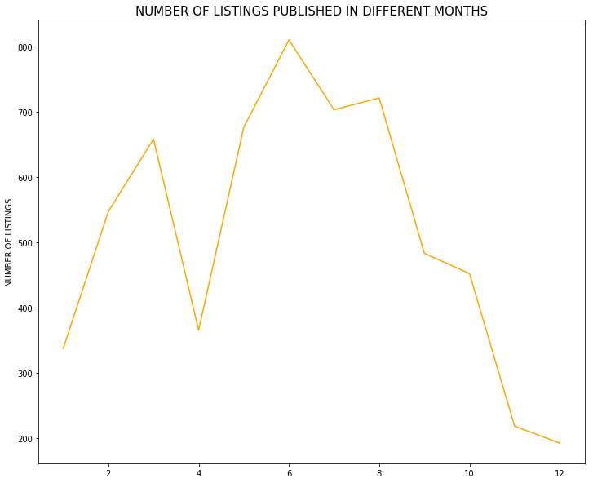
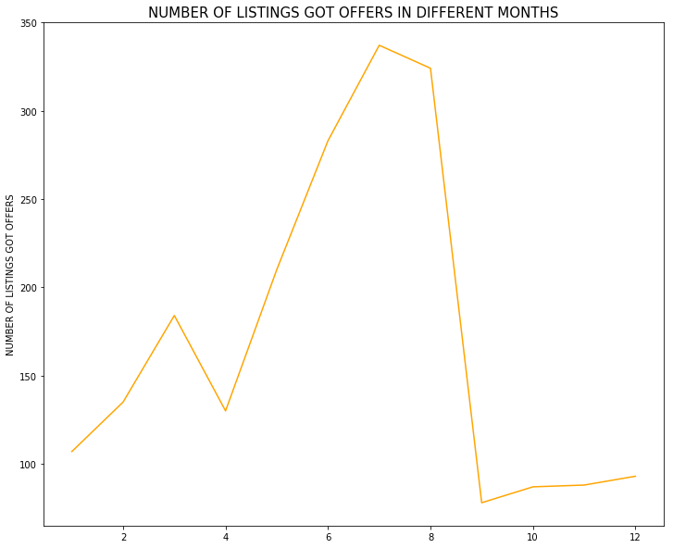
Publish Month
There is seasonality in this industry. Winter is the season with the low number of transactions. Spring and summer have more transaction activities.

Slide 32
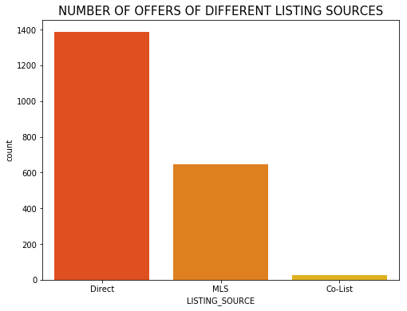
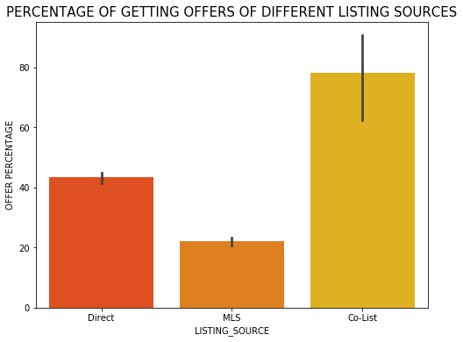
Offers from different Listing Sources
Listings directly from RoofStock have relatively better performance since the number of offers is the highest. We recommend RoofStock to invest more on marketing to attract house owners. Listings listed exclusively on Roofstock have a higher proportion of getting offers.
Findings

Slide 33
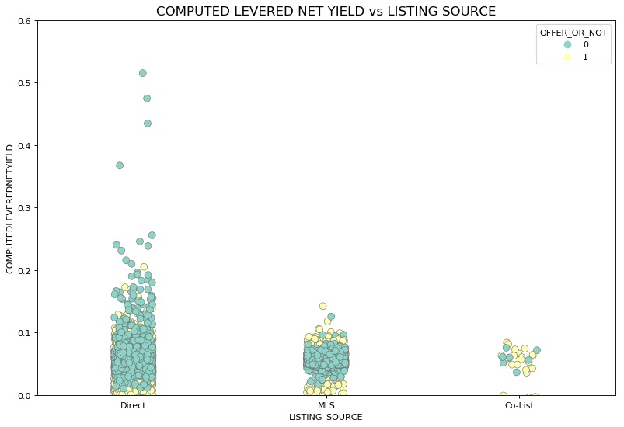
Computed Levered Net Yield from different Listing Sources
Findings
In general, the listings listed exclusively on Roofstock have the highest net yield and the MLS market has the lowest net yield.
RoofStock could leverage this information to attract more buyers to Roofstock’s platform.

Slide 34
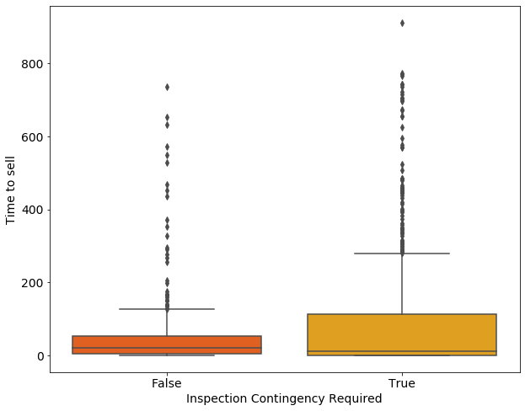
Time to sell and Inspection Contingency Required
Findings
The range of time to sell for (INSPECTION_CONTINGENCY_REQUIRED=False) is much shorter than the range of time to sell (INSPECTION_CONTINGENCY_REQUIRED=True).
Inspection required leads to a longer time to sell.
Sellers could make the inspection process more smoothly to reduce time to sell.

Slide 35
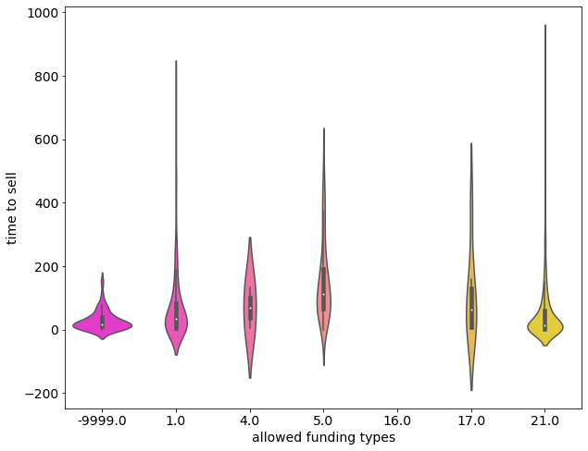
Time to sell and Allowed funding types
Findings
When FUNDINGTYPES is 5, listing has the longest time to sell.
When FUNDINGTYPES is -9999.0 (NA), the listing is fastest to be sold.

Slide 36
Executive Summary
5
Data Overview
Data Preprocessing
Exploratory Data Analysis
th
Data Modeling
Recommendations

Slide 37
Modeling Criterion
Train the model with information on both listings with offers and listings without offers.
Baseline: Randomly guessing, Majority class
Model evaluation metric: MAE(Continuous target variable, MAE is easy to interpret)
F(list price, offer price(i)) -> days to offer at offer price(i)

Slide 38
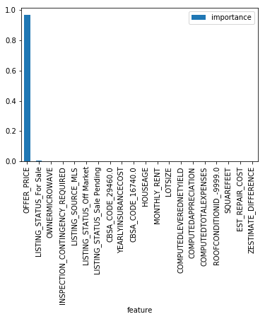
First Try to Predict ‘Time to sell’
X: listing static data + list price + offer price
Y: time to get the offer
The model performed perfectly, we got a perfect number: MAE is 3 days which means the average error is within 3 days
From the importance plot, the OFFER_PRICE has the most chances to do the splits.
We found that this should be wrong because, during every split, the tree only needs to decide whether the discount is low:
Low discount --- no offer --- 180 days (no error)
High discount --- has offer --- predict with some errors
In the training data, we have more than 60% no offer observations. The models are highly biased by the negative samples.
Hard to handle!!

Slide 39

K means with Clusters = 2
We tried k-means to extract data insight and found an impressive point:
When k=2, the offer_or_not can be divided clearly.
How about building 2-step models?
1st: Predict whether one listing has offer or not?
2nd: If yes, predict time to get one offer.
 | offer_or_not=1 | offer_or_not=0
Cluster 1 | 0.61 | 0.39
Cluster 2 | 0.3 | 0.7

Slide 40
2-Step Model Step 1: Classifier for OFFER_OR_NOT
In this part, we use ALL the records to be our training data. From k-means, we assume that our training data has strong power in predicting OFFER_OR_NOT.
After tuning hyperparameters (eg: for RF: 10*20*2*10), we got accuracy with cross validation as follows: (imbalanced data, using AUC and mAP as evaluation metrics)
 | Logistic | KNN | SVC | XGBoost | Random Forest | Baseline
Accuracy | 0.69 | 0.91 | 0.76 | 0.81 | 0.989 | 0.63
AUC | 0.67 | 0.89 | 0.63 | 0.79 | 0.989 | 0.5
mAP | 0.34 | 0.82 | 0.51 | 0.65 | 0.92 | 0.37

Slide 41
Feature Importance for Sanity Check
We expect to see those ensemble methods (XGBoost) perform better than KNN, but in our output, KNN performs better.
01
We got a nearly 99% accuracy by random forest because this performance is surprisingly good, so we decide to use feature importance to check whether there are some crucial features we can’t put into the model (just like 180 days and offer price).
02

Slide 42
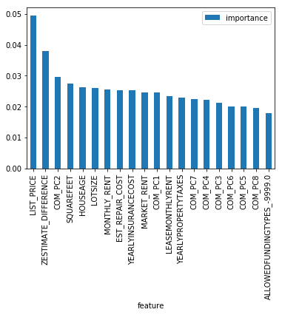
Feature Importance for Sanity Check
All variables share reasonable amount of importance in the importance plot which means that we did not include some dominant features.
All PCs are all shown on the feature importance chart, indicating that house property features and financial features are very important.

Slide 43
2-Step Model
Step 2: Prediction for Time to sell
In this part, we only use “has-offer-listing” records to be our training data.
1
It can avoid problems that ‘No offer listings’ have no offer price and offer records.
2
The second model is only using for listings with offers(because they already pass the offer_or_not model), so it will not skew the results.

Slide 44
2-Step Model
Step 2: Models Performance for Time to sell
After tuning hyperparameters, our MAE with cross validation are as followings:
 | SGD | Neural Network | XGBoost | Random Forest | LASSO
MAE | 42.3 | 33.5 | 23.58 | 9.91 | 26.9
MSE | 2615.3 | 754.2 | 896.09 | 308.3 | 1187

Slide 45
Survival Analysis
To let model know record changings are from different days:
 | LISTING_ID | LIST_PRICE | DIFF_DAYS | OFFER_OR_NOT | DAY_ON_MARKET | OFFER_TOMORROW?
0 | 1625006 | 10,000 | 30 | 0 | 1 | 0
1 | 1625006 | 8,000 | 30 | 0 | 2 | 0
... | 1625006 | ... | 30 | ... | ... | ...
28 | 1625006 | 6,000 | 30 | 0 | 29 | 1

Slide 46
Survival Analysis
To encode List_price record changing among different days:
 | LISTING_ID | LIST_PRICE | DAY_ON_MARKET | OFFER_TOMORROW? (y label) | INITIAL_LIST_PRICE | CURRENT_LIST_PRICE
0 | 1625006 | 10,000 | 1 | 0 | 10,000 | 10,000
1 | 1625006 | 8,000 | 2 | 0 | 10,000 | 8,000
... | 1625006 | ... | ... | ... | 10,000 | ...
28 | 1625006 | 6,000 | 29 | 1 | 10,000 | 6,000

Slide 47
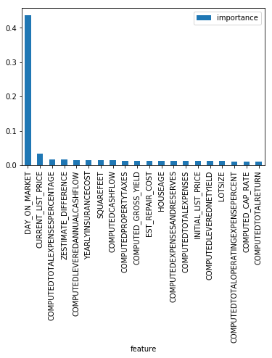
Survival Analysis
How to transform a classification model back to a regression model?
 | LISTING_ID | DAY_ON_MARKET | OFFER_TOMORROW? (y label) | Probability of having offer tomorrow
0 | 1625006 | 1 | 0 | 0.335
1 | 1625006 | 2 | 0 | 0.421
... | 1625006 | ... | ... | ...
28 | 1625006 | 29 | 1 | 0.878
... | 1625006 | ... | ... | ...
178 | 1625006 | 179 | 0 | 0.211

Slide 48
Survival Analysis
How to transform a classification model back to a regression model?
 | LISTING_ID | DAY_ON_MARKET | INITIAL_LIST_PRICE | CURRENT_LIST_PRICE | OFFER_TOMORROW? (y label) | Probability of having offer tomorrow
0 | 1625006 | 1 | 10,000 | 10,000 | 0 | 0.335
1 | 1625006 | 2 | 10,000 | 8,000 | 0 | 0.421
... | 1625006 | ... | 10,000 | ... | ... | ...
28 | 1625006 | 29 | 10,000 | 6,000 | 1 | 0.878

Slide 49
Survival Analysis
After tuning hyperparameters, our MAE with cross validation are as follows:
 | Logistic | SVC | XGBoost | Random Forest
MAE | 42.3 | 29 | 35.8 | 3.7
MSE | 2265.4 | 763.6 | 1011.2 | 361

Slide 50
Executive Summary
6
Data Overview
Data Preprocessing
Exploratory Data Analysis
th
Data Modeling
Recommendations

Slide 51
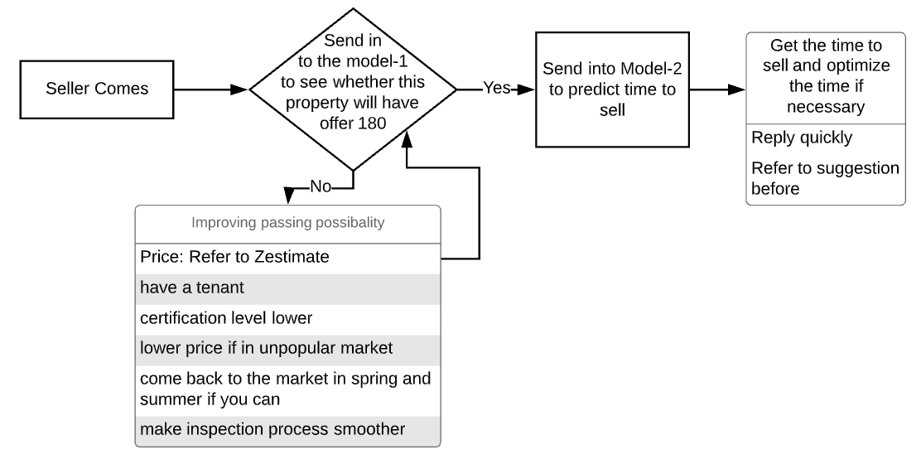

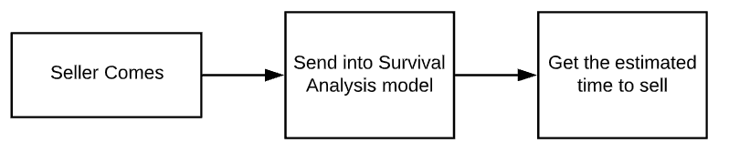
Recommendations
1.
Use A/B testing to investigate which model works better
2.

Slide 52



General Recommendations
Invest more on branding
Promotion to call for action
For Roofstock
Send seller notification
Using promotion in low transaction seasons

Slide 53


Future Work
External Data
Survival Analysis
Financial Concepts
Use more external data, such as crime data, Education Levels, Life Quality Standards, Air Pollution, Race and Ethnicity, Employment and Occupation, Available Houses for Rent and Sale.
Try to implement Cox regression and explore more about Survival Analysis.
Conduct research to understand financial terms and concepts in variables.

Slide 54


THANKS

